Slide 1
Module 2
Integrating SaaS Services Available on the Azure Platform
Notes:
Presentation: 60 minutes
Lab: 60 minutes
After completing this module, students will be able to:
Identify when Cognitive Services, Bot Service or Machine Learning is appropriate for their solution.
Compare the various features available in Media Services and determine the appropriate features for their solution.
Required materials
To teach this module, you need the Microsoft PowerPoint file: 20535A_10.pptx.
Preparation tasks
To prepare for this module, you should:
Read all of this module’s materials.
Practice performing the demonstrations and labs.
Work through the Module Review and Takeaways section to determine how you will use the information to reinforce student learning and promote knowledge transfer to on-the-job performance.
As you prepare for this class, it is imperative that you complete the labs yourself. This gives you an understanding of how the labs work and the concepts that each covers, so that you can provide meaningful hints to students who might have issues. Furthermore, it will help guide your lecture to ensure that you discuss the concepts that the lab covers.
The Azure portal is continually being improved, and the user interface might have updated since this module was written. Therefore, before teaching this module, familiarize yourself with the latest version of the Azure portal.
20535A
10: Integrating SaaS Services Available on the Azure Platform

Slide 2
Module Overview
Bot Services Machine Learning Media Processing
Cognitive Services
Notes:
20535A
10: Integrating SaaS Services Available on the Azure Platform

Slide 3
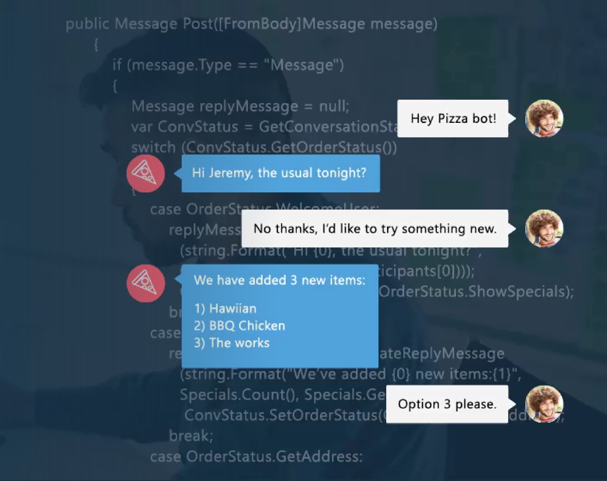
Lesson 1: Bot Services
Notes:
Bots are intended to interact with your users naturally where they are:
Text/SMS
Skype
Slack
Messenger
Office 365
Mail
Other Popular Services
20535A
10: Integrating SaaS Services Available on the Azure Platform

Slide 4
Bot Framework
Tools for building bots:
Build web sites with card-based UI
Build services to enrich existing applications
Implement mechanisms to receive events and act on them
Uses industry-standard protocols
Built-in conversation modeling tools
Integrated LUIS
Built-on common patterns
Notes:
20535A
10: Integrating SaaS Services Available on the Azure Platform

Slide 5
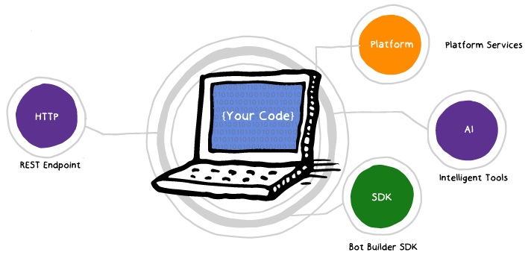
Bot Framework
Notes:
REST Endpoint (Direct Line Protocol).
Your code contains conversational and business logic.
Application is “Canvas Aware” where it knows if it's hosted in Cortana, Bing, Skype or other services.
20535A
10: Integrating SaaS Services Available on the Azure Platform

Slide 6
Bot Services
Develop using App service-compatible programming languages
Quick-start templates
Integrated chat window:
Embeddable web chat
Support for channels:
Kik, Twilio, Skype, Slack, Microsoft Teams, etc.
Cognitive Services integration
Direct Line support
Notes:
20535A
10: Integrating SaaS Services Available on the Azure Platform

Slide 7

Bot Services
Powered by Azure Functions:
Serverless
Continuous Deployment
Auto-scale
Built-in code editor
Integrates with various databases and services
Notes:
20535A
10: Integrating SaaS Services Available on the Azure Platform

Slide 8













One Bot, Many Canvases
Custom Skills
Business Bots
LOB Bots
Memory / Profile
Bot Directory
IT Managed
Speech
Bots in Bing Search
Integrated Auth
Notes:
The features for each canvas can vary wildly.
20535A
10: Integrating SaaS Services Available on the Azure Platform

Slide 9
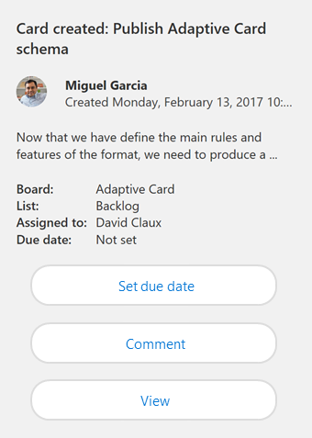
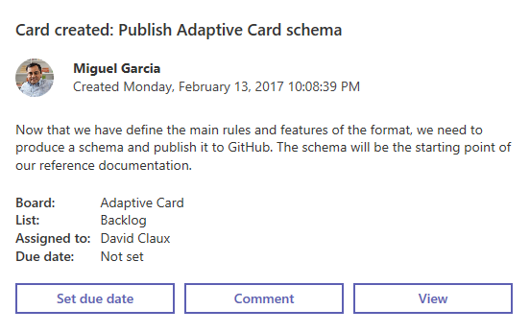
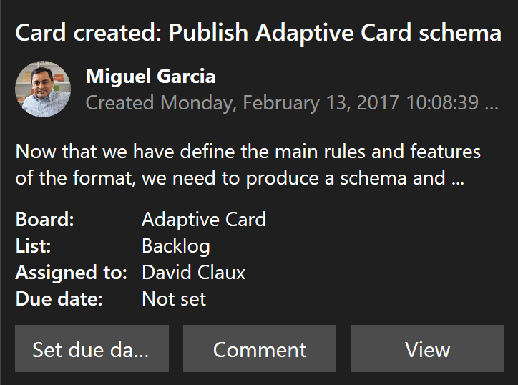
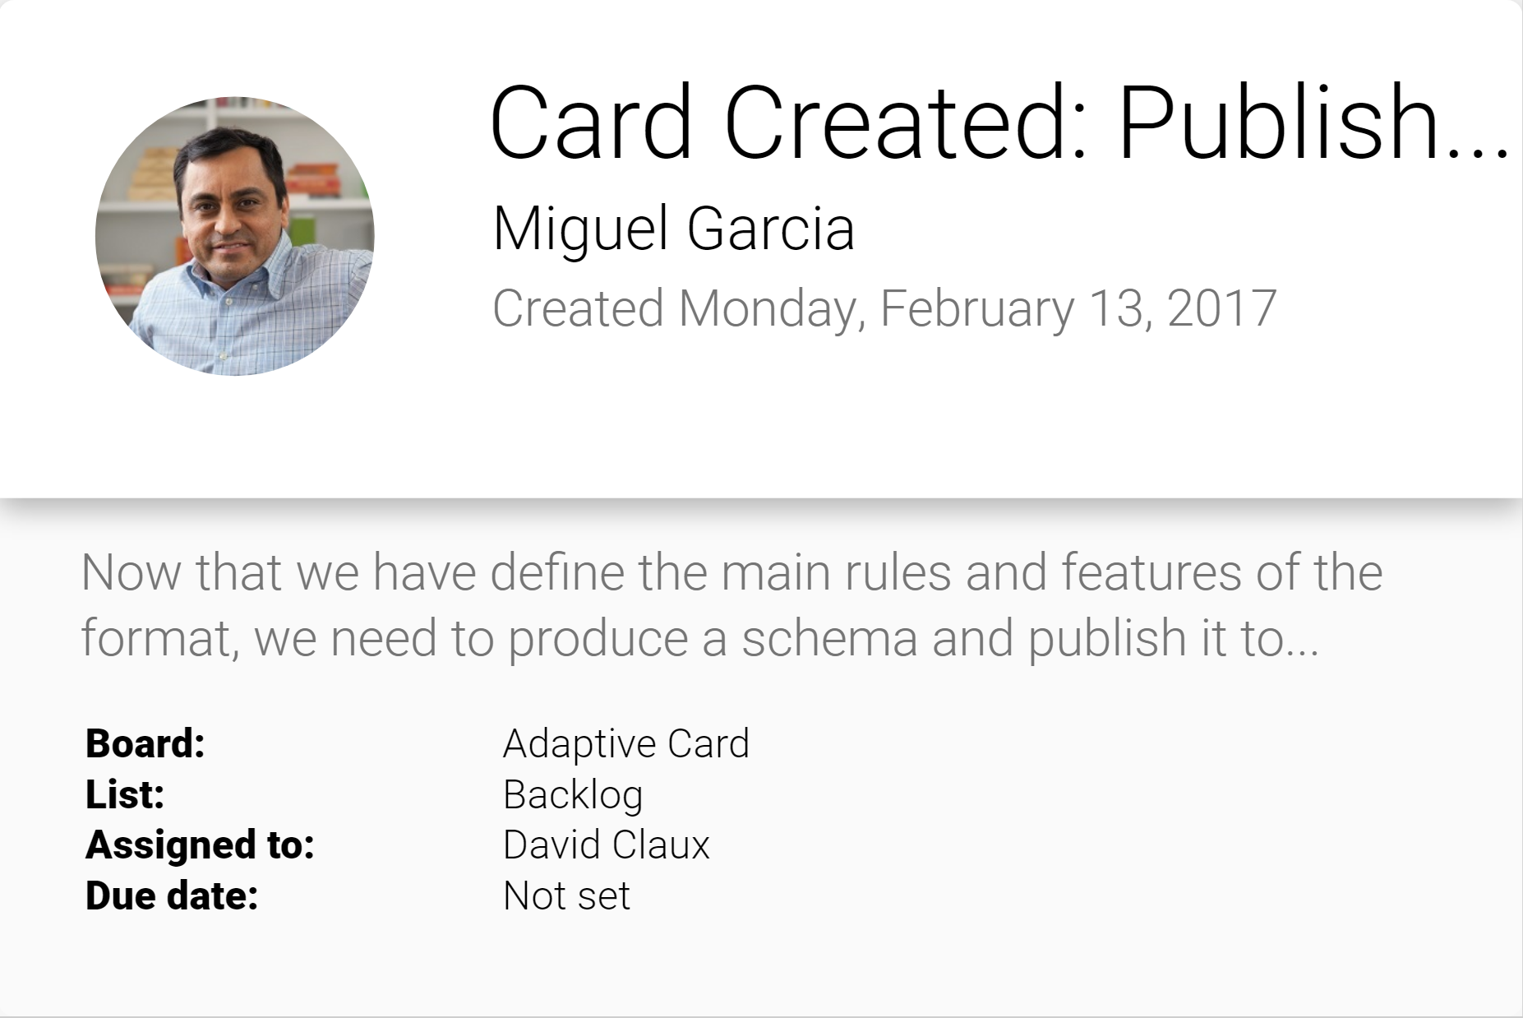
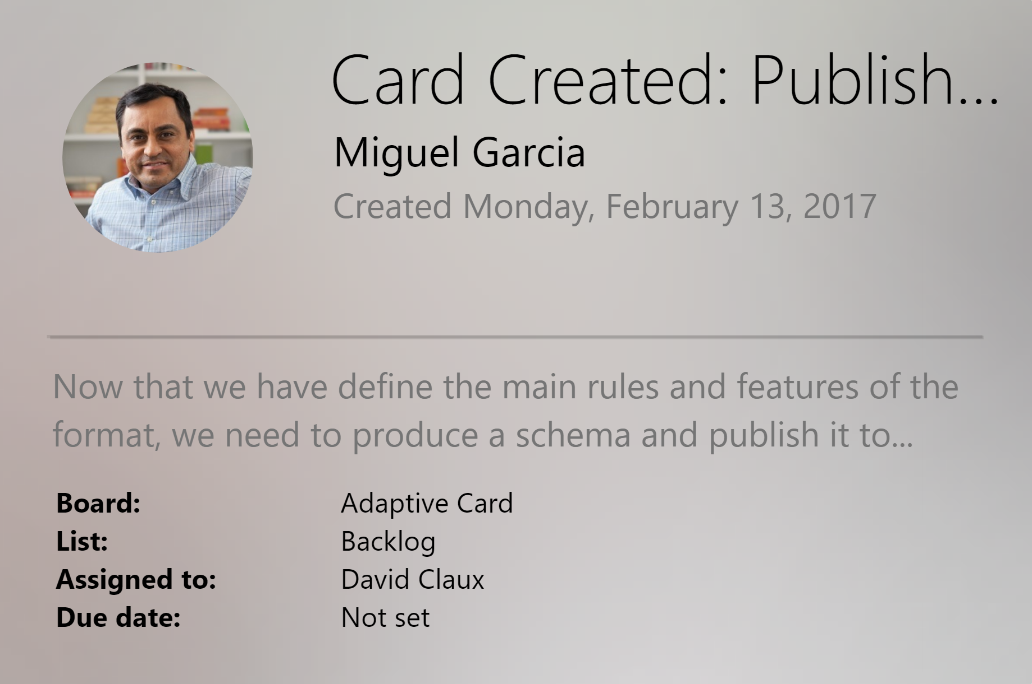
One Bot, Many Canvases
Notification
Microsoft Teams
Skype
Android
iOS
Notes:
The UI for each canvas can also be drastically different.
20535A
10: Integrating SaaS Services Available on the Azure Platform

Slide 10
QnA Maker
Web-based service that simplifies the process of creating a bot to answer simple questions for your users:
Bot's knowledge can be imported from an existing FAQ document or web page
Service creates a Bot for you without the need to write custom code
Bot can be trained and modified using the QnA Maker portal
Bot is available as a REST API
Notes:
20535A
10: Integrating SaaS Services Available on the Azure Platform

Slide 11
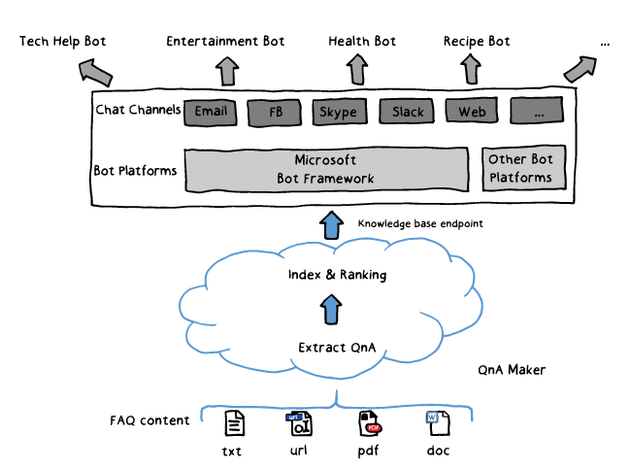
QnA Maker
Notes:
20535A
10: Integrating SaaS Services Available on the Azure Platform

Slide 12
Lesson 2: Machine Learning
Machine Learning
Notes:
20535A
10: Integrating SaaS Services Available on the Azure Platform

Slide 13
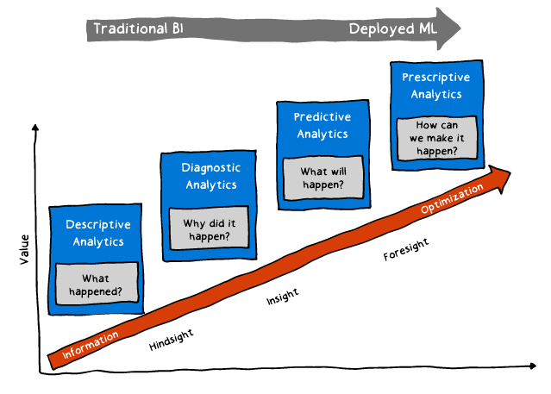
Machine Learning
Difficulty
Notes:
Our analysis is moving from trying to figure out what happened to trying to figure out what will happen.
Focus on prescription over description.
20535A
10: Integrating SaaS Services Available on the Azure Platform

Slide 14



Machine Learning
25 different machine learning algorithms
Modules for importing and cleaning data
Create experiments to train and test models
Publish models as web service (REST)
1
De/Refine business problem
5
Monitor model's performance
2
Extract data
1
Define Target / Metric
5
Evaluate Model
2
Extract Derived Features
4
Deploy model
3
Develop model through iterations
4
Fit Model
3
Select Features
Notes:
20535A
10: Integrating SaaS Services Available on the Azure Platform

Slide 15
Machine Learning
Example of Algorithms:
Classification: Assign a category to each item
Regression: Predict a real value for each item
Ranking: Order items according to some criterion
Clustering: Partition items into homogeneous groups
Dimensionality reduction: Transform an initial representation of items into a lower-dimensional representation while preserving some properties
Notes:
Classification: Ex. stock/currency value, temperature
Ranking: Ex. web search results relevant to a user query
Clustering: Ex. clustering twitter posts by topic
Dimensionality reduction: Ex. preprocessing of digital images
20535A
10: Integrating SaaS Services Available on the Azure Platform

Slide 16
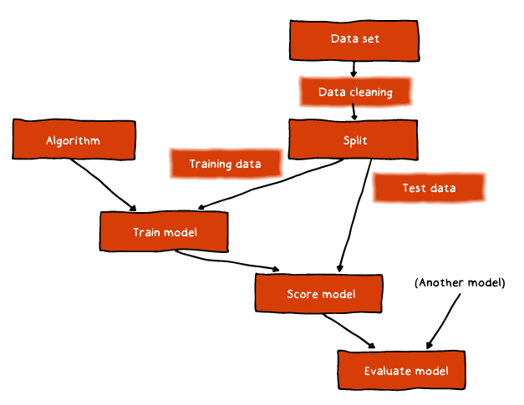
Machine Learning
Notes:
This is a model detailing supervised learning within the context of Azure ML.
20535A
10: Integrating SaaS Services Available on the Azure Platform

Slide 17

Discussion
What are examples of business use cases for machine learning algorithms?
Notes:
20535A
10: Integrating SaaS Services Available on the Azure Platform

Slide 18
Lesson 3: Media Processing
Media Services Computer Vision API
Notes:
20535A
10: Integrating SaaS Services Available on the Azure Platform

Slide 19
Media Services
Traditional video management and delivery challenges:
Infrastructure costs:
Specifically, bandwidth and storage
Maintenance and management complexity:
How do you maintain millions of clips?
Monetizing content:
Can’t simply host a MP4 file out in the open
DRM:
How do you protect content from theft?
Security:
How do you protect privileged content?
Notes:
Use a “clip show” as an example where the show highlights clips from other television programs throughout the day. They may go through 1000s of clips every day to find their content and they need to store this information somewhere.
20535A
10: Integrating SaaS Services Available on the Azure Platform

Slide 20




















Media Services
“Build-On” Media Partners and Customers
REST APIs
Partner CDNs
iOS
Media Services
XBOX 360
Secure
Media Ingest
Encoding
On-Demand
Origin
Live Ingest
Live Origin
Advertising
HTML 5
Media Job
Scheduling
Static/Dynamic Packaging
Content Protection
Live Encoding
Analytics
Identity Management
Windows
Phone
Azure CDN
Android
Partner Technologies (Media Processors, Origin Servers, Live Encoders etc.)
Flash
(Fabric, Storage, Compute, Database)
Origin
Adaptive Streaming
Porting Kits
Caching
Notes:
Many of the features of Media Services are available as a first-party or third-party option.
20535A
10: Integrating SaaS Services Available on the Azure Platform

Slide 21






Media Services
Video Processing
Video-on-demand
Video analytics
Ingest
Encode
Package
Encrypt
Deliver
Notes:
20535A
10: Integrating SaaS Services Available on the Azure Platform

Slide 22
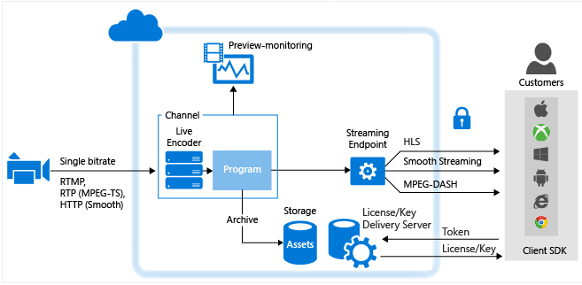
Live Streaming
Notes:
20535A
10: Integrating SaaS Services Available on the Azure Platform

Slide 23








Video Format Conversion
Media Services Output in Azure Storage
Video Source
Raw Video
Media Services
Notes:
Media Services can encode videos as a job. This is good for pre-recorded content.
20535A
10: Integrating SaaS Services Available on the Azure Platform

Slide 24







Dynamic Video Packaging
Dynamic Packaging Server
Multi-Bitrate Video
Video Source
Raw Video
Media Services
Notes:
Dynamic packaging converts the video into the appropriate package type on-demand when requested.
This is a more expensive operation as far as compute utilization but it saves a tremendous amount on storage if you have a wide variety of devices accessing your content using specific protocols.
20535A
10: Integrating SaaS Services Available on the Azure Platform

Slide 25
Computer Vision API
Algorithms for Processing Images:
Tag images based on content
Categorize images
Identify the type and quality of images
Detect human faces and return their coordinates
Recognize domain-specific content
Generate descriptions of the content
Use optical character recognition to identify printed text found in images
Notes:
20535A
10: Integrating SaaS Services Available on the Azure Platform

Slide 26
Computer Vision API
Algorithms for Processing Images:
Recognize handwritten text
Distinguish color schemes
Flag adult content
Crop photos to be used as thumbnails
Notes:
20535A
10: Integrating SaaS Services Available on the Azure Platform

Slide 27

Image Tagging
'tags': [
{
"name":"grass", "confidence":0.999999761581421 },
{
"name":"outdoor", "confidence":0.999970674514771 },
{
"name":"sky",
"confidence":999289751052856 },
{
"name":"building", "confidence":0.996463239192963 },
{
"name":"house", "confidence":0.992798030376434 },
{
"name":"lawn",
"confidence":0.822680294513702 },
{
"name":"green", "confidence":0.641222536563873 },
{
"name":"residential",
"confidence":0.314032256603241
},
]
Notes:
20535A
10: Integrating SaaS Services Available on the Azure Platform

Slide 28

Description Generation
"description": {
"captions": [
{
"type":"phrase",
"text":"a black and white photo of a large city",
"confidence":0.607638706850331 },
{
"type":"phrase",
"text":"a photo of a large city",
"confidence":0.577256764264197
},
{
"type":"phrase",
"text":"a black and white photo of a city",
"confidence":0.538493271791207
}
],
"tags": {
"outdoor",
"city",
"building",
"photo",
"large"
}
}
Notes:
20535A
10: Integrating SaaS Services Available on the Azure Platform

Slide 29



Color Schemes
Image | Foreground | Background | Colors
 | Black | Black | White
 | Black | White | White, Black, Green
 | Black | Black | Black
Notes:
20535A
10: Integrating SaaS Services Available on the Azure Platform

Slide 30
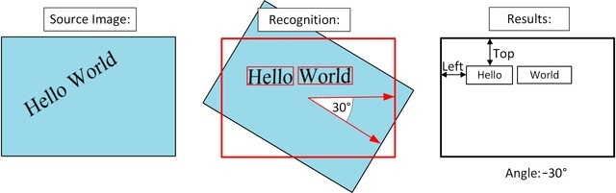
Optical Character Recognition (OCR)
Notes:
20535A
10: Integrating SaaS Services Available on the Azure Platform

Slide 31
Discussion
If you are hosting video using Media Services, what parameters would you use to decide between statically converted or dynamically packaged videos?
Notes:
20535A
10: Integrating SaaS Services Available on the Azure Platform

Slide 32
Lesson 4: Cognitive Services
Cognitive Services Intent Detection Cognitive APIs
Notes:
20535A
10: Integrating SaaS Services Available on the Azure Platform

Slide 33
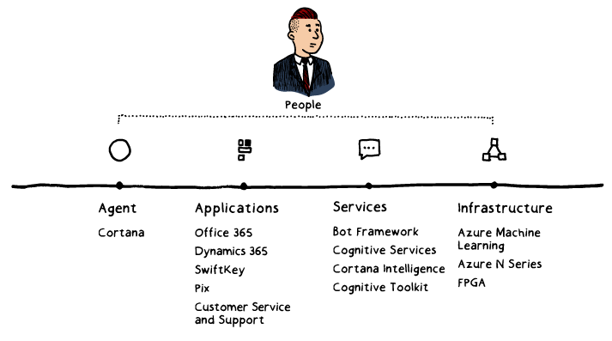
Cognitive Services
Notes:
Microsoft's portfolio of AI services range across a variety of platforms and some services are more mature (Cortana) while others are newer (Cognitive Services).
20535A
10: Integrating SaaS Services Available on the Azure Platform

Slide 34
Cognitive Services
Data
Intelligence
Experiences
AI Platform
Intelligent Agents
AI Solutions
Applications
Notes:
20535A
10: Integrating SaaS Services Available on the Azure Platform

Slide 35
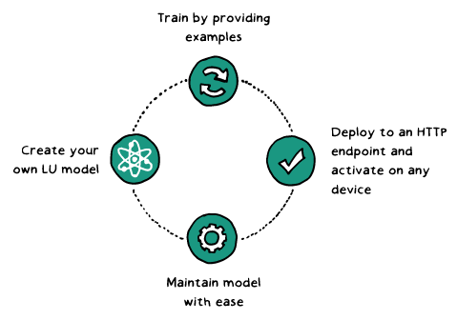
Language Understanding (LUIS)
Notes:
Language understanding in human-computer interaction is:
Technically challenging:
It's exceedingly difficult to enable a computer to understand what a person wants and to find the pieces of information that are relevant to their intent.
Costly to implement:
Building and maintaining machine learning systems requires a large investment of time, money and engineering resources.
Often domain specific:
In the past, building your own machine learned models often required assistance of a team of data scientists that would customize the models to the specific domain.
20535A
10: Integrating SaaS Services Available on the Azure Platform

Slide 36
Language Understanding (LUIS)
Focus on Intents, Utterances and Entities
Intent | Utterance | Entities
BookFlight | "Book a flight to Seattle?" | Seattle
StoreHoursAndLocation | "When does your store open?" | open
ScheduleMeeting | "Schedule a meeting at 1pm with Bob in Distribution" | 1pm, Bob
Notes:
Intents
An intent represents actions the user wants to perform. The intent is a purpose or goal expressed in a user's input, such as booking a flight, paying a bill, or finding a news article. You define and name intents that correspond to these actions. A travel app may define an intent named "BookFlight."
Utterances
An utterance is text input from the user that your app needs to understand. It may be a sentence, like "Book a ticket to Paris", or a fragment of a sentence, like "Booking" or "Paris flight." Utterances aren't always well-formed, and there can be many utterance variations for a particular intent.
Entities
An entity represents detailed information that is relevant in the utterance. For example, in the utterance "Book a ticket to Paris", "Paris" is a location. By recognizing and labeling the entities that are mentioned in the user's utterance, LUIS helps you choose the specific action to take to answer a user's request.
20535A
10: Integrating SaaS Services Available on the Azure Platform

Slide 37

Language Understanding (LUIS)
Book me a flight to Cairo
Order me 2 pizzas
Remind me to call my dad tomorrow
Where is the nearest club?
{
“query”: “book me a flight to Cairo”,
“topScoringIntent”: {
“intent”: “BookFlight”,
“score”: 0.9887482
},
“intents”: [
…
]
}
Notes:
The intents array typically contains a collection of other intents (including the top scoring intent) that were identified in the utterance.
20535A
10: Integrating SaaS Services Available on the Azure Platform

Slide 38
Cognitive APIs
Computer Vision
Content Moderator
Emotion API
Face API
Video Indexer
Bing Speech Service
Speaker Recognition
Translator Speech
Linguistic Analysis
Text Analytics
Translator Text
Custom Decision Service
Entity Linking
Knowledge Exploration Service (KES)
Recommendations
Academic Knowledge
Language Understanding (LUIS)
QnA Maker
Notes:
This is NOT an exhaustive list.
20535A
10: Integrating SaaS Services Available on the Azure Platform

Slide 39
Face API
Cloud-based service to detect and recognize faces:
Detects up to 64 human faces
Provides a “face location” within the image
Image can be provided as part of the request (bytes) or externally (URL)
Notes:
20535A
10: Integrating SaaS Services Available on the Azure Platform

Slide 40
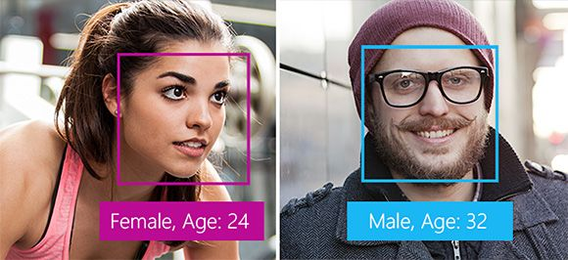
Face API
Face location
Submitted faces
Metadata about face
Notes:
20535A
10: Integrating SaaS Services Available on the Azure Platform

Slide 41
Face API
Face Verification:
Authentication using a face
Finding Similar Faces:
Find faces that look most similar
Face Grouping:
Groups faces based on similarities
Face Identification:
Detect a face based on a “known people” database
Notes:
20535A
10: Integrating SaaS Services Available on the Azure Platform

Slide 42
Discussion
If you were building a mobile app that manages real estate listings, what are some of the LUIS intents you could create?
Notes:
20535A
10: Integrating SaaS Services Available on the Azure Platform

Slide 43
Online Lab - Integrating SaaS Services Available on the Azure Platform
Exercise 1: Deploy Function App and Cognitive Service using ARM Template Exercise 2: Create a Logic App that uses a Function App
Exercise 3: Remove lab resources
Estimated Time: 60 minutes
Notes:
This lab assumes that students have their own Azure subscriptions that do not contain any existing cloud services, storage accounts, or Azure SQL Database servers.
Azure is continually improving, so the user interface might have been updated since this lab was written. Before students start the lab, make them aware of any differences between the steps described in the lab and the current user interface.
Exercise 1: Deploying Function App and Cognitive Service using ARM Template
Exercise 2: Cleanup Subscription
20535A
10: Integrating SaaS Services Available on the Azure Platform

Slide 44
Lab Review
What other scenarios would require you to deploy a Cognitive Services instance in an ARM Template?
Notes:
Question
What other scenarios would require you to deploy a Cognitive Services instance in an ARM Template?
Answer
You could deploy a cognitive service along with a Logic App, VM, Web App or ACS instance.
20535A
10: Integrating SaaS Services Available on the Azure Platform

Slide 45
Module Review and Takeaways
Review Question
Notes:
Review Question
Question
How would a bot that you create for Slack behave and look different than a bot that’s created for SMS/Text Messaging?
Answer
The Slack bot would have the Slack application available as it’s canvas and will need to both look like it’s native to Slack and take advantage of Slack capabilities.
The SMS bot will need to only send text content that is within the SMS message limits allowed by mobile carriers.
20535A
10: Integrating SaaS Services Available on the Azure Platform

